Slide 1
Quanvolutional neural network
20/5/2022
https://arxiv.org/abs/1904.04767
https://arxiv.org/abs/2108.00661.pdf

Slide 2
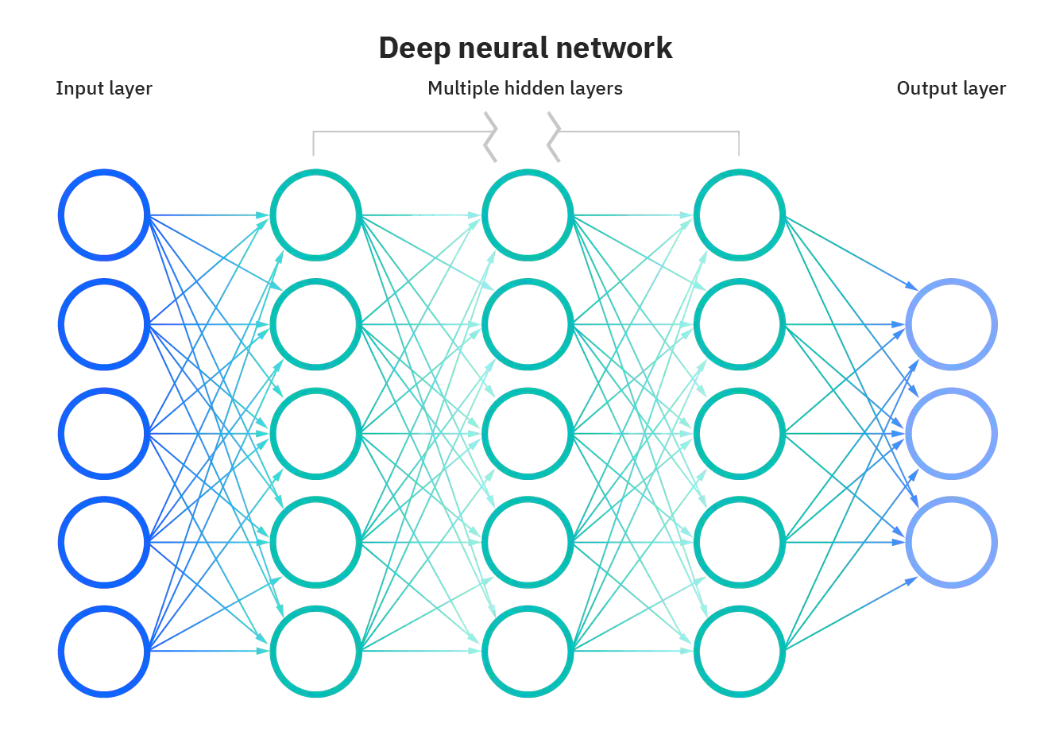
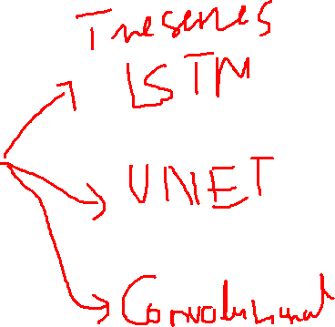
Neural network

Slide 3
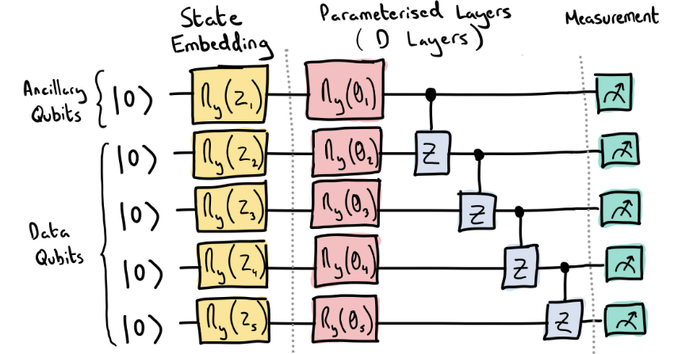
Quantum neural network

Slide 4
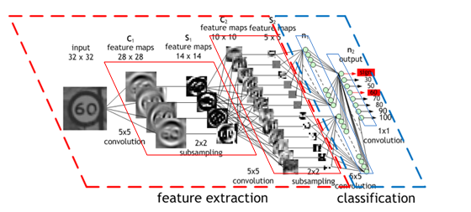
Convolutional neural network

Slide 5
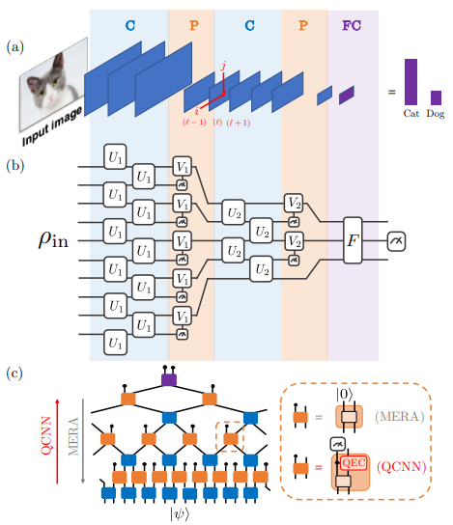
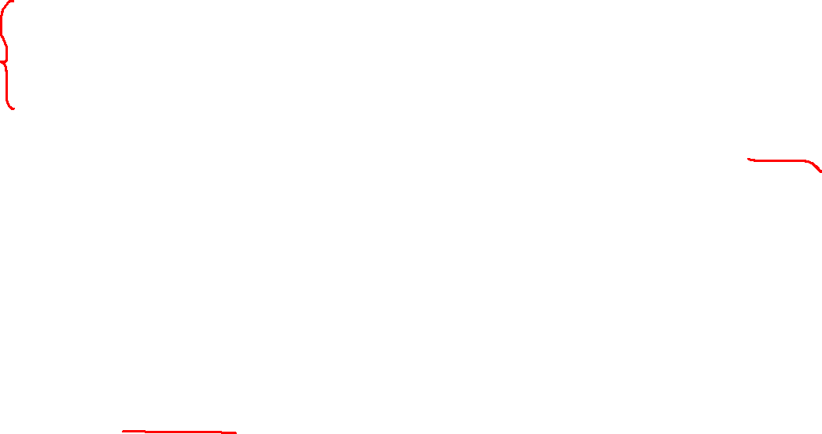
Quantum convolutional neural network
Absence of Barren Plateaus in Quantum Convolutional Neural Networks, PRX, 11,041011 (2021)

Slide 6
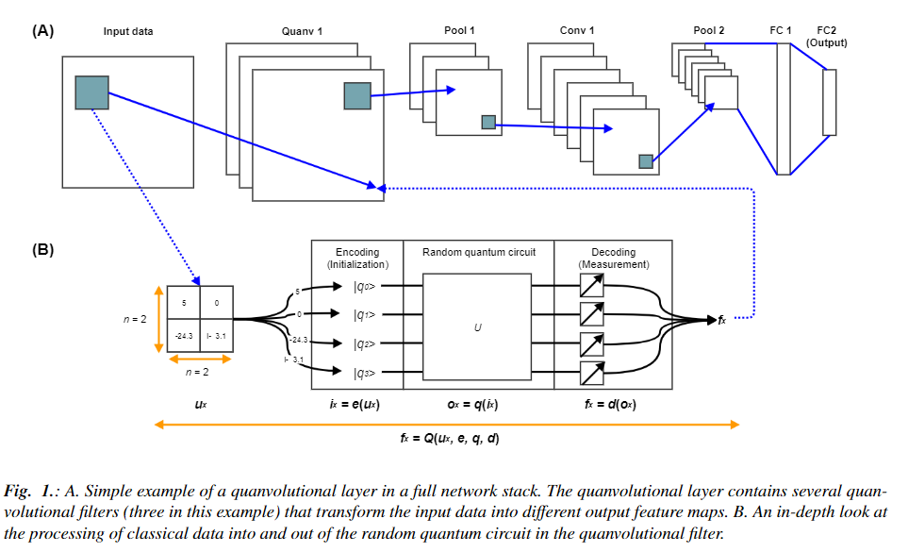
Overall structural

Slide 7
Models
QNN model
CNN model
(look like Lenet)
Image: 28x28x1
Image: 28x28x1
Quanv1: 3x3 random number of filters
Conv1: 50 5x5 filter
Conv1: 50 5x5 filter
Pool1
Pool1
Conv2: 64 5x5 filter
Conv2: 64 5x5 filter
Pool2
Pool2
FC1: 1024. Dropout = 0.4
FC1: 1024. Dropout = 0.4
FC2: 10. Droput = 0.4
FC2: 10. Droput = 0.4

Slide 8
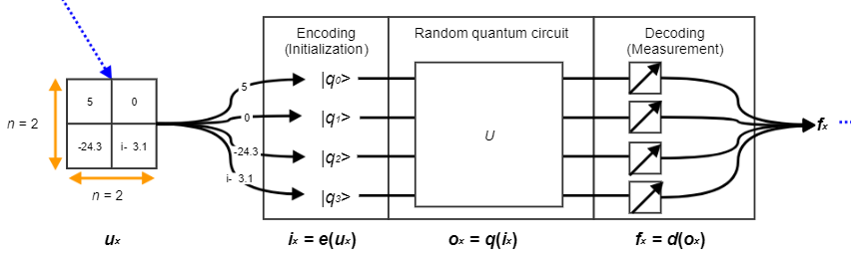
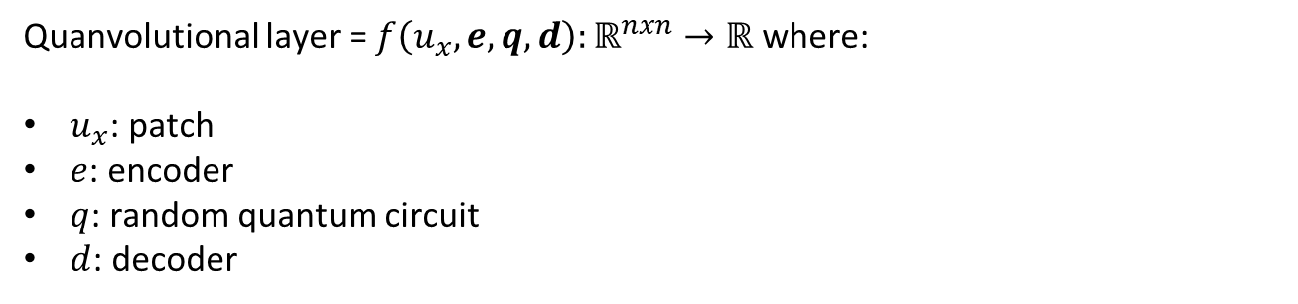

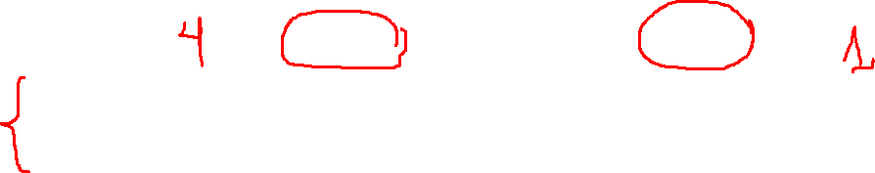
Quanvolutional layer
Quanvolutional layer = $f\left(u_{x},e,q,d\right):ℝ^{nxn}→ℝ$ where:
$u_{x}$: patch
$e$: encoder
$q$: random quantum circuit
$d$: decoder

Slide 9
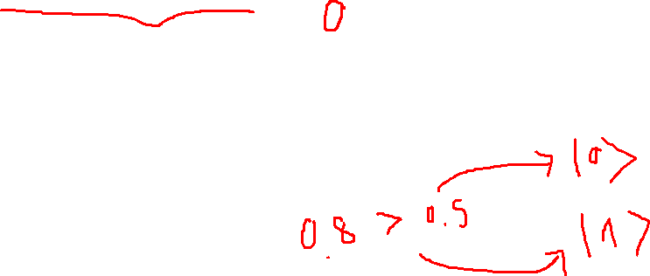

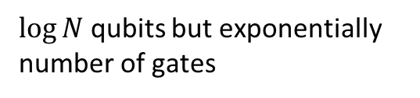
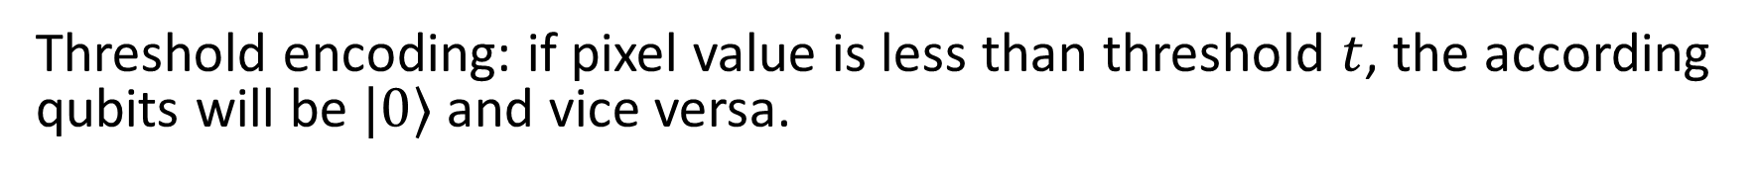
Encoding & Decoding
$\log{N}$ qubits but exponentially number of gates
$e:ℝ^{nxn}→|ψ⟩$
Amplitude encoding
$N$ qubit, linear number of gate
Threshold encoding: if pixel value is less than threshold $t$, the according qubits will be $|0⟩$ and vice versa.
$d:\left|ψ\right\rangle →ℝ$

Slide 10
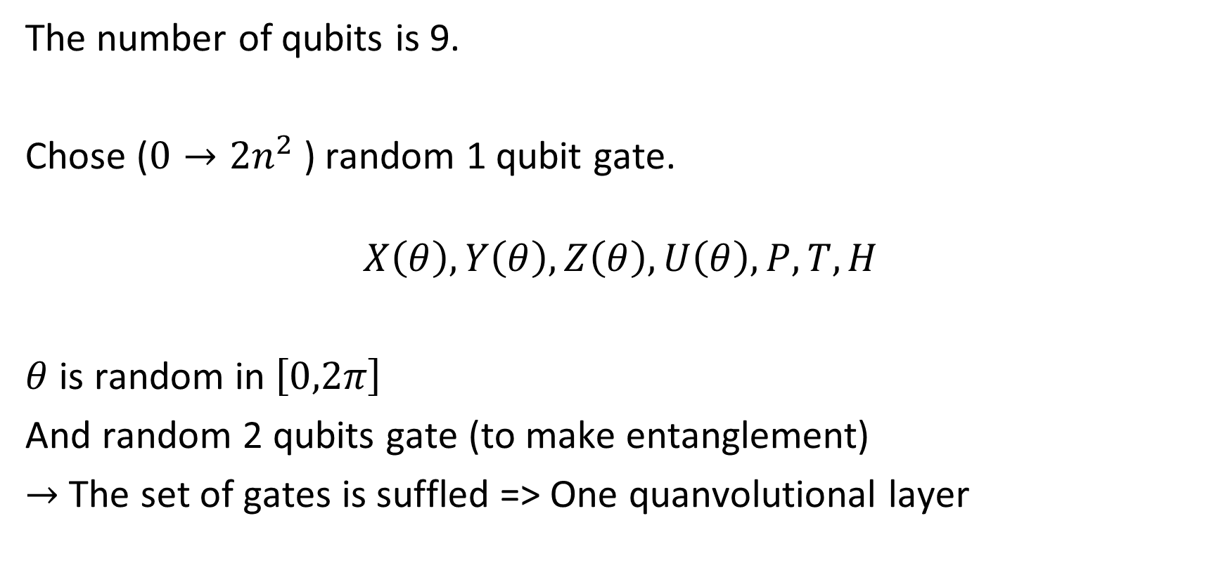
Quantum circuit
The number of qubits is 9.
Chose ($0→2n^{2}$) random 1 qubit gate.
$$X\left(θ\right),Y\left(θ\right),Z\left(θ\right),U\left(θ\right),P,T,H$$
$θ$ is random in $\left[0,2π\right]$
And random 2 qubits gate (to make entanglement)
$→$ The set of gates is suffled => One quanvolutional layer

Slide 11
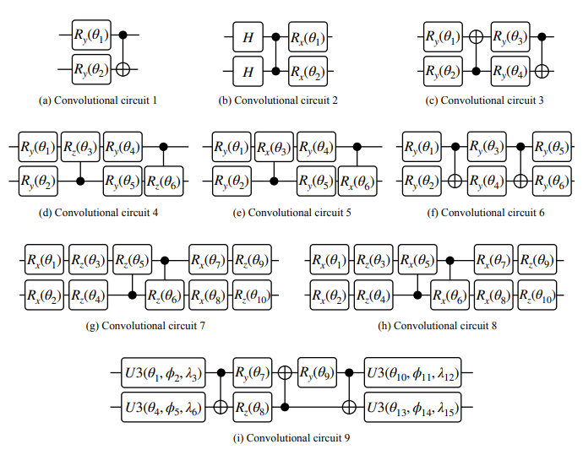
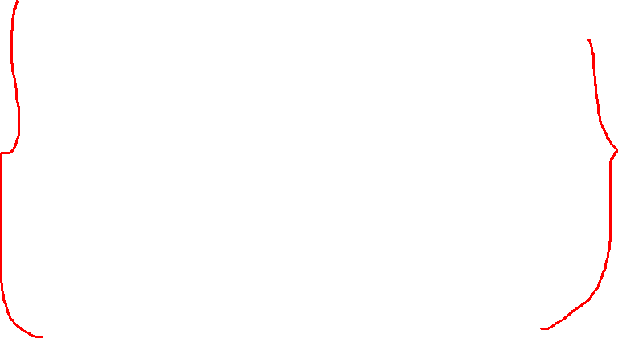
Quantum circuit: Example

Slide 12

Quantum advantages
Quantum computers can access kernel functions in highdimensional Hilbert spaces much more efficiently than classical computers.
$→$ Coverage faster

Slide 13
Disadvatanges
Number of measurements
Number of quanvolutional filters

Slide 14
Dataset
70k 28x28 gray MNIST samples (60k train, 10k test)

Slide 15
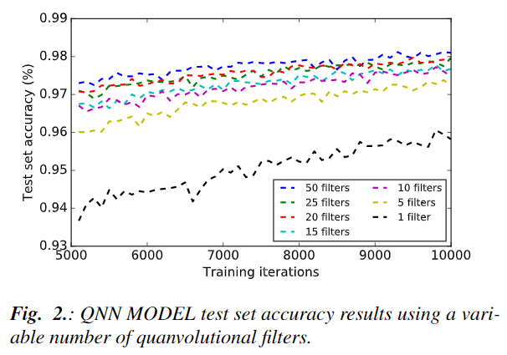
Results

Slide 16
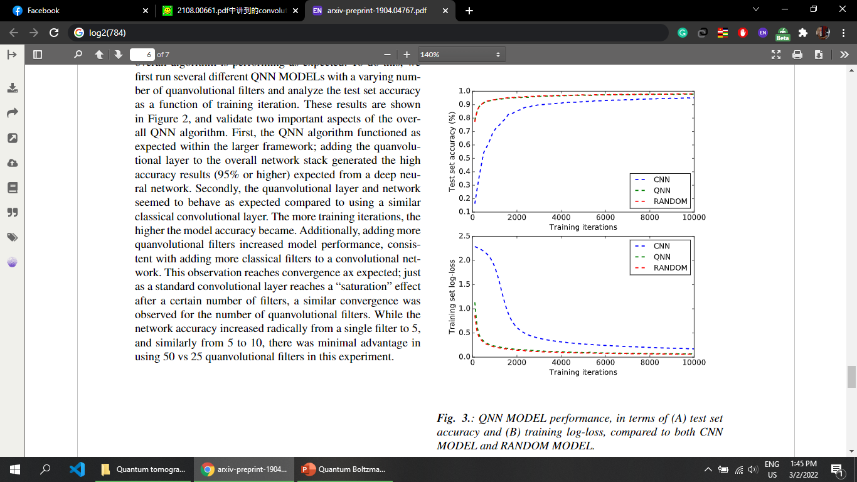
Results

Slide 17
Future works
Test on another dataset and deeper QNN.
Make quanvolutional layer trainable or change by time by the evolutional / genetic algorithm. => Use QNG in quanvolutional layer

Slide 18


Tested model
Image: 28x28x1
Image: 28x28x1
Image: 28x28x1
Conv1: $n$ filter
Quantum filters
FC1: 1024. Dropout = 0.4
MaxPool1
FC2: 10. Dropout = 0.4
Conv2: $n$ filter
MaxPool2
FC1: 1024. Dropout = 0.4
FC1: 1024. Dropout = 0.4
FC2: 10. Dropout = 0.4
FC2: 10. Dropout = 0.4
Model H1: Lenet
Model H2: Hybrid
Model H3: Without quanv

Slide 19
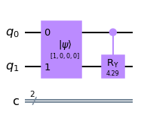
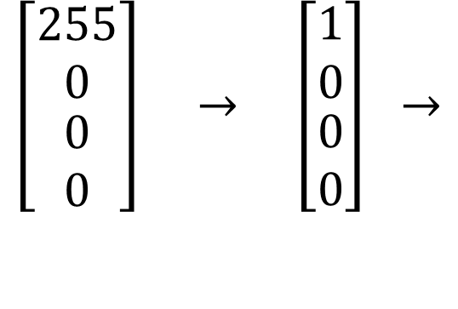
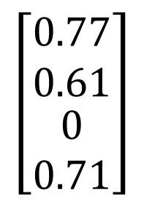


Quanv layer / filter
Random $R_{Y}$ gate
$$\left[\begin{matrix}\begin{matrix}0.77 \\ 0.61\end{matrix} \\ 0 \\ 0.71\end{matrix}\right]$$
$$\left[\begin{matrix}\begin{matrix}255 \\ 0\end{matrix} \\ 0 \\ 0\end{matrix}\right] → \left[\begin{matrix}\begin{matrix}1 \\ 0\end{matrix} \\ 0 \\ 0\end{matrix}\right] →$$
$$→$$
Normalize
Load
Measure
2 x 2 filter
Probability vector

Slide 20
Accuracy QNN vs CNN:
Dataset:
MNIST, MNIST Fashion (60000 train, 10000 test)
Train / val / test: 1200 / 300 / 300 (take randomly)
Training:
Run 20 times.
Batch size: 4, number of epoch: 100, Loss: cross entropy, Optimizer: Adam
Compare on:
1. Type of quanvolution filter
2. Number of filter
3. Size of filter

Slide 21
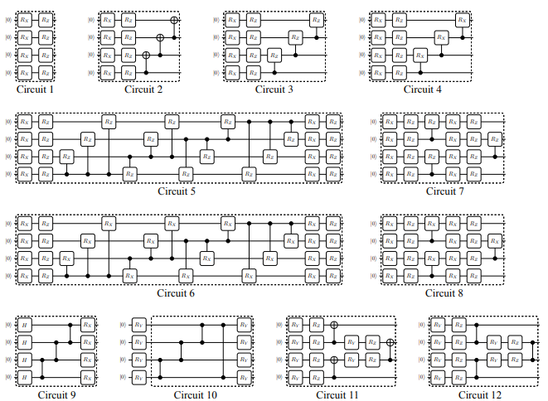
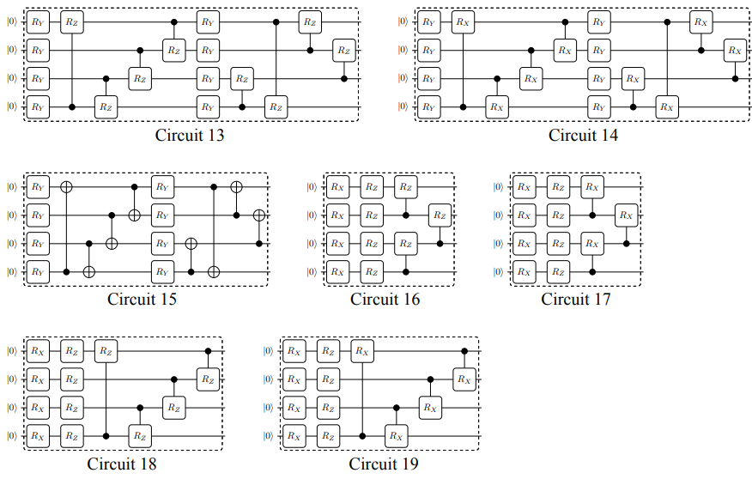
1. Is entangled circuit better quanv filter?
Expressibility and entangling capability of parameterized quantum circuits for hybrid quantum-classical algorithms

Slide 22
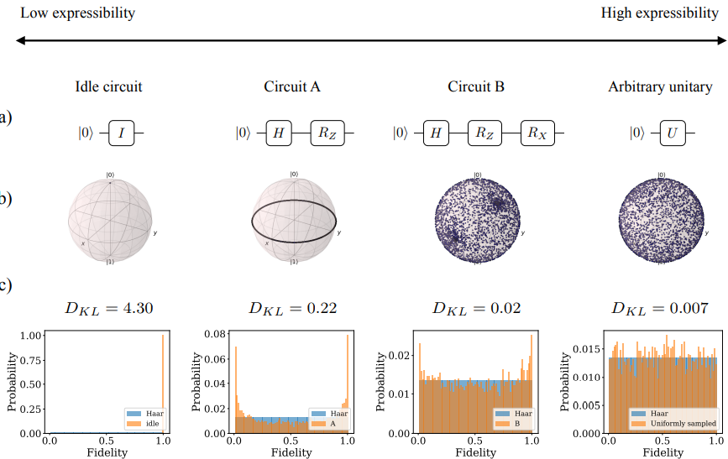
1. Expressibility

Slide 23
1. Something about quanv filter
Entangled properties in quantum filter acts as a compresser.
More entangle, less number of iteration.

Slide 24
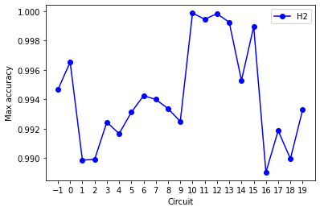
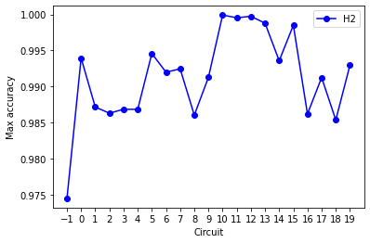
1. Different between quanv filters (4x4, 4 filter)
4x4 circuit 0
2x2 circuit 0
MNIST
MNIST Fashion

Slide 25
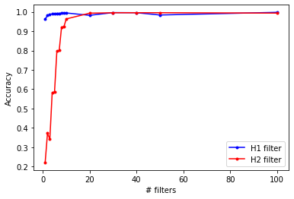
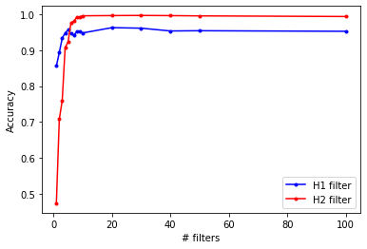
2. Different between number of filter
Train and test on MNIST
Train and test on MNIST Fashion
From 1 to 100 filters

Slide 26
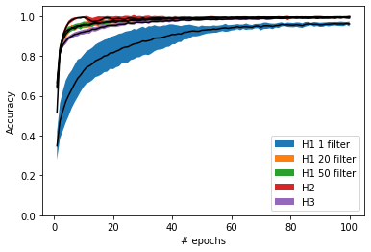
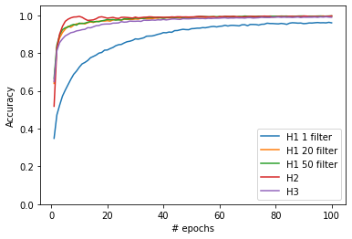
2. Different between number of filter on MNIST
Mean and Std accuracy
Mean accuracy

Slide 27
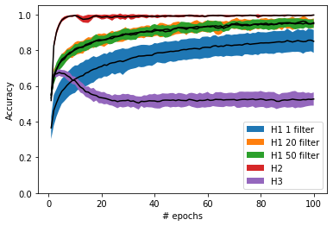
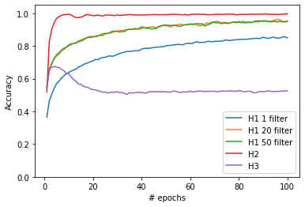
2. Different between number of filter on MNIST Fashion
Mean and Std accuracy
Mean accuracy

Slide 28
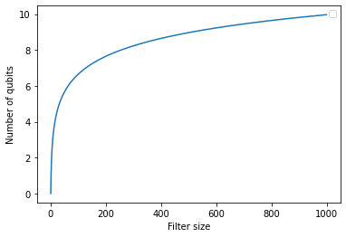
3. Filter size

Slide 29
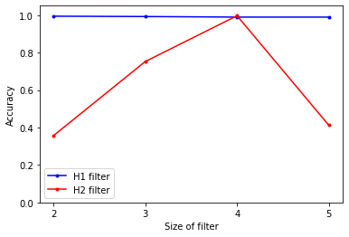
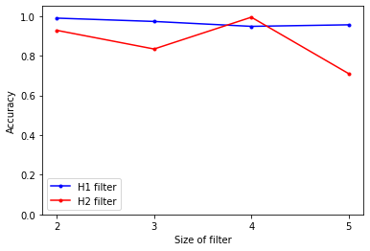
3. Filter size
Train and test on MNIST
Train and test on MNIST Fashion

Slide 30

Advanced of quanv filter
We increase the number of quanv filter by adding more random circuit.
One random circuit $n$ qubit is equivalent to $2^{n}$ filter $2^{n}x2^{n}$. That means we can increase the number of quanv filter rapidly.

Slide 31
Draw

Slide 32
a)
b)
c)
Image
Image
Image
Conv1
Quantum filters
MaxPool1
Conv2
MaxPool2
FC1
FC2
Output

